Slide 1
ADVERBS OF MANNER
Silvije Devald M.A.
Vladimir Nazor Primary School
Daruvar, Croatia

Slide 2
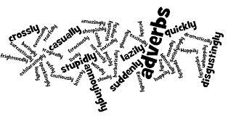

Slide 3
Usage of adverbs Uporaba priloga
adverbs answer to the question how? or in what way?
prilozi odgovaraju na pitanje kako? ili na koji način?

Slide 4
Usage of adverbs Uporaba priloga
adverbs can be used to describe verbs, adjectives, other adverbs or entire clauses
priloge koristimo za opisivanje glagola, pridjeva, drugih priloga ili cijelih surečenica
She drives carefully.
He is largely responsible for the problem.
They spoke barely audibly.
Unfortunately, I met him already.

Slide 5
Formation of adverbs Tvorba priloga
adverbs are formed by adding the ending –ly to the adjective
adjective + ly
prilozi se tvore dodavanjem nastavka –ly na pridjev

Slide 6
Spelling changes Promjene u pisanju
adjectives ending in –y, preceded by a consonant, change the final –y to –i
happy happily
easy easily
pridjevi koji završavaju na –y, ispred kojega je suglasnik, pretvaraju završni –y u -i

Slide 7
Spelling changes Promjene u pisanju
adjectives ending in –le just transform the ending to –ly
simple simply
terrible terribly
pridjevi koji završavaju na –le samo pretvaraju završetak u -ly

Slide 8
Exceptions Iznimke
there is only one irregular adverb:
good well
He speaks good English.
He speaks English well.
samo je jedan nepravilan prilog

Slide 9
Exceptions Iznimke
some adverbs have the same form as adjectives:
fast, hard, late
lovely, friendly
neki prilozi imaju isti oblik kao i pridjevi

Slide 10
Exceptions Iznimke
some adverbs have a different meaning from the original adjectives
neki prilozi imaju značenje različito od izvornih pridjeva
hardly = almost no
fairly = to some extent
lately = recently

Slide 11
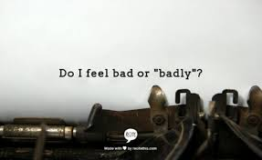
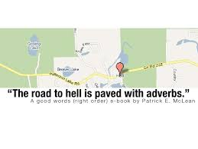

Slide 12
Thank you for your attention!

