Slide 1
MODAL VERBS
Silvije Devald M.A.
Vladimir Nazor Primary School
Daruvar, Croatia

Slide 2
can, could, will, would,
shall, should, may, might, need, must, ought to, dare, used to

Slide 3
Modal Verbs
form a special group
don’t exist in the Croatian language
important in the German language (können, sollen, wollen, wissen ...)
čine zasebnu skupinu
ne postoje kao posebna skupina u hrvatskom
važni u njemačkom jeziku

Slide 4
Features of the Modal Verbs Posebnosti modalni glagola
always followed by a main verb in the infinitive form
uvijek se koriste uz glavni glagol u infinitivu
You can open your books.

Slide 5
Features of the Modal Verbs Posebnosti modalni glagola
do not add the ending –s in 3rd person singular in the Present Simple Tense
ne dobivaju nastavak –s u 3. licu jednine sadašnjosti
She can ride a bike.

Slide 6
Features of the Modal Verbs Posebnosti modalni glagola
do not form the continuous and perfect tenses
ne tvore continuous i perfect glagolska vremena
*You are maying go out.
*I have could swim.

Slide 7
Features of the Modal Verbs Posebnosti modalni glagola
form the negative by just adding the „not”, without another auxiliary verb
niječni oblik tvore dodavanjem niječnice „not”, bez drugih pommoćnih glagola
We should not drink alcohol.

Slide 8
Features of the Modal Verbs Posebnosti modalni glagola
form the questions by inversion, without another auxiliary verb
upitni oblik tvore inverzijom, bez drugog pomoćnog glagola
Should she read the message?

Slide 9
Features of the Modal Verbs Posebnosti modalni glagola
some modal verbs have alternative verbal forms
neki modalni glagoli imaju zamjenske oblike
can – be able to
may – be allowed to
must – have to

Slide 10
Features of the Modal Verbs Posebnosti modalni glagola
„must” has two negatives:
grammatical – mustn’t
logical – needn’t
„must” ima dvije negacije
gramatičku – mustn’t (= ne smjeti)
logičku – needn’t (= ne morati)

Slide 11
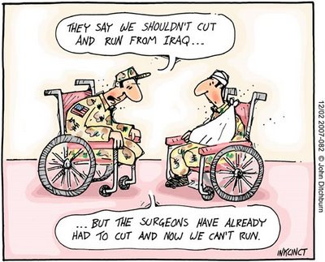
Thank you for your attention!

