Slide 1
PAST SIMPLE TENSE
Silvije Devald M.A.
Vladimir Nazor Primary School
Daruvar, Croatia

Slide 2
Past Simple Tense
no auxiliary verb in the affirmative form
nema pomoćnog glagola u jesnom obliku
denotes completed actions in the past
opisuje prošle svršene radnje

Slide 3
To be
was – I, he, she, it
were – you, we, they
She was happy with her boyfriend.
They were in the park.
He wasn’t ready for work
We weren’t proud of our school.
Was it really that awful?
Were you home last night?

Slide 4
Regular Verbs Pravilni glagoli
form the Past Simple by adding –(e)d to the infinitive
tvore Past Simple dodavanjem nastavka –(e)d na infinitiv
phone – phoned
walk - walked

Slide 5
Regular Verbs Pravilni glagoli
doubling of the last consonant
udvostručavanje zadnjeg suglasnika
drop – dropped
transfer - transferred

Slide 6
Regular Verbs Pravilni glagoli
verbs ending in –y change the final –y to –ie
glagoli koji završavaju na –y pretvaraju završni –y u –ie
try – tried
multiply – multiplied
but: play – played
destroy - destroyed

Slide 7
Irregular Verbs Nepravilni glagoli
have a special form for the Past Simple
imaju poseban oblik za Past Simple
found in the second column of the Irregular Verbs’ Chart
nalazi se u drugom stupcu Tablice nepravilnih glagola

Slide 8
Irregular Verbs Nepravilni glagoli
make – made
take – took
have – had
sleep – slept
catch – caught
come - came

Slide 9
Negative Form Niječni oblik
auxiliary “didn’t” and the infinitive of the main verb
pomoćni glagol “didn’t” i infinitiv glavnog glagola
I went home after the concert.
I didn’t go home after the concert.

Slide 10
Question form Upitni oblik
auxiliary verb “did”, subject, infinitive of the main verb
pomoćni glagol “did”, subjekt, infinitiv glavnog glagola
She made a cake for her birthday.
Did she make a cake for her birthday?

Slide 11
Fill in the sentence with the appropriate Past Simple form of the verb in brackets:
He ________ a new career. (start)
She __________ the answer. (know)
They ___________ bread yesterday. (not buy)
We ___________ the film. (not like)
___ you ______ a party? (prepare)
I _______ to school this morning. (run)
My friend _________ an angry letter. (write)
His parents _______ the promise. (break)

Slide 12
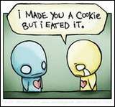
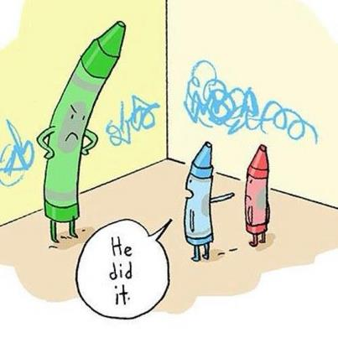
Thank you for your attention!

