Slide 1
PRESENT PERFECT SIMPLE TENSE
Silvije Devald M.A.
Vladimir Nazor Primary School
Daruvar, Croatia

Slide 2
Present Perfect Simple Tense
auxiliary verb „to have” and the Past Participle of the main verb
pomoćni glagol „to have” i particip prošli glavnog glagola
connects the past and the present
povezuje prošlost i sadašnjost

Slide 3
Past Participle
regular verbs form it by adding –(e)d and irregular verbs use the form from the 3rd column of the Irregular Verbs’ Table
pravilni glagoli tvore ga dodavanjem nastavka –(e)d, a nepravilni glagoli koriste oblik iz trećeg stupca Tablice nepravilnih glagola
work – worked
sleep - slept

Slide 4
Usage Uporaba
for actions that started in the past and are still happenning
za radnje koje su počele u prošlosti i još uvijek traju
She has lived in Daruvar all her life.

Slide 5
Usage Uporaba
for past actions that we still feel the consequences of
za prošle radnje čije posljedice još osjećamo
He has given up smoking.

Slide 6
Usage Uporaba
for past actions that we do not know the exact time of happenning
za prošle radnje kojima ne znamo točno vrijeme događanja
I have seen Titanic.

Slide 7
Usage Uporaba
with adverbs: ever, never, already, just, yet
uz spomenute priloge
They have already done their homework.

Slide 8
Usage Uporaba
with prepositions: since (denoting a moment in time) and for (denoting a period of time)
uz prijedloge: since (uz trenutke u vremenu) i for (uz vremenska razdoblja)
I have learnt English since 2004.
I have learnt English for 8 years.

Slide 9
Meaning Značenje
depending on the context, the Present Perfect Simple is sometimes denoting a past and sometimes a present action
ovisno o kontekstu, Present Perfect ponekad prevodimo sadašnjim, a ponekad prošlim vremenom.

Slide 10
Fill in the sentence with the appropriate Present Perfect Simple form of the verb in brackets:
He ________ a new career. (start)
She __________ the answer. (know)
They ___________ bread yesterday. (not buy)
We ___________ the film. (not like)
___ you ______ a party? (prepare)
I _______ to school this morning. (run)
My friend _________ an angry letter. (write)
His parents _______ the promise. (break)

Slide 11
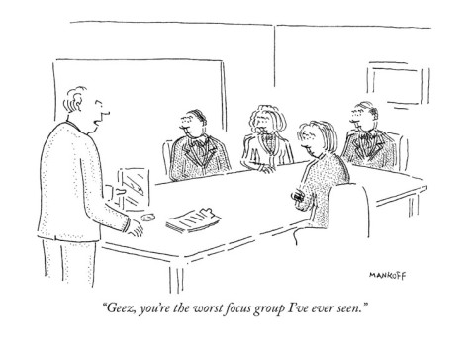

Slide 12
Thank you for your attention!

