Slide 1
PAST CONTINUOUS TENSE
Silvije Devald M.A.
Vladimir Nazor Primary School
Daruvar, Croatia

Slide 2
Past Continuous Tense
was/were + present participle
(infinitive+ing)
She was watching TV at 8 o’clock.

Slide 3
Present Participle Particip sadašnji
infinitive + ing
used in all continuous tenses (Present Continuous, Present Perfect Continuous...)

Slide 4
Present Participle Particip sadašnji
verbs ending in a consonant preceded by a short vowel double the last consonant
glagoli koji završavaju na suglasnik ispred kojeg je kratki samoglasnik, udvostručuju zadnji suglasnik
sit – sitting
swim – swimming
cut - cutting

Slide 5
Present Participle Particip sadašnji
verbs ending in silent –e lose the –e
glagoli koji završavaju na –e koje se en izgovara, gube to –e
take – taking
write – writing
have - having

Slide 6
Present Participle Particip sadašnji
verbs ending in –ie change the final –ie into –y
glagoli koji završavaju na –ie, pretvaraju završno –ie u –y
lie – lying
die – dying
but: dye - dying

Slide 7
Usage Uporaba
past action happening at a specific time in the past
prošla radnja koja je bila u tijeku u određenom trenutku u prošlosti
I was reading a book at 11 last night.

Slide 8
Usage Uporaba
two past actions happening at the same time
dvije prošle radnje koje su se odvijale istovremeno
He was having dinner while his sister was washing the dishes.

Slide 9
Usage Uporaba
a long past action interrupted by a short action
duga prošla radnja koju prekida kratka radnja
He was doing his homework when the telephone rang.

Slide 10
Fill in the sentence with the appropriate Past Continuous or Past Simple form of the verb in brackets:
They __________ when somebody ______ on the door. (sleep, knock)
While he _____________ a text message his phone _________ dead. (write, go)
We _____________ Twister last Sunday. (play)
You _____________ to music while I ______________ a cake. (listen, make)

Slide 11
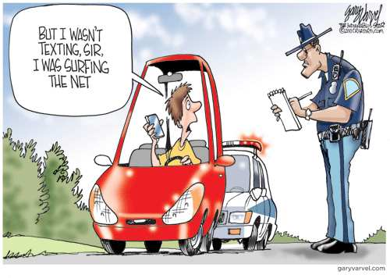

Slide 12
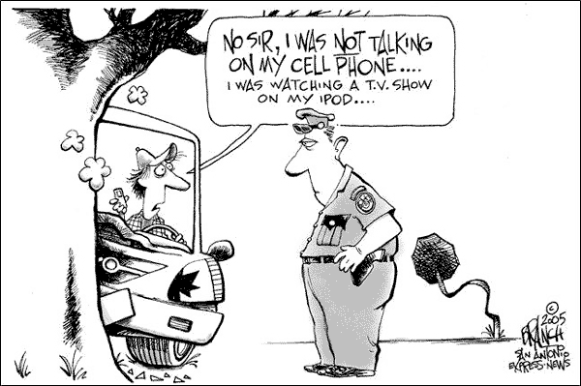
Thank you for your attention!

